Slide 1
syrmDesign with staircase airgap induction
March 24 2017
simone.ferrari@polito.it

Slide 2
Content
syrmDesign flowchart
New parameter definition: kt
Staircase evaluation
d-axis evaluation
Minor modifications
FEA verification

Slide 3
syrmDesign flowchart
start
staircase evaluation
geometric definitions
d-axis evaluation
q-axis evaluation
Slot area and leakage
Torque and PF evaluation
NOTE:
The green blocks are added in this release. The yellow blocks are modified in this release.
The order in the performance evaluation is slightly different in the script.
Flux barrier design (hc)
Flux carrier design (dx)
end

Slide 4
New tooth factor definition: kt
The new factor kt is defined as the ratio (lower than 1) between the tooth width evaluated to have a tooth induction equal to the yoke induction, and the final tooth width.
A smaller tooth cause:
a reduction of the ratio between the maximum airgap induction and the yoke induction
a possible increase of the peak of the first harmonic in the airgap, respect to the maximum induction allowed at the airgap
an increasing of the slot area, that means an higher rated current

Slide 5
Staircase evaluation
Ideally, the airgap induction is a sinewave. The effect of the stator teeth make the airgap induction a staircase, which copy the original sine (called generator in the following slides).
In the proposed analysis, the staircase is used to evaluate the shape factor to obtain the mean value and the peak of the first harmonic of the staircase, starting from the maximum airgap induction (b*Bfe).
Using a per-unit notation, where the base value is b*Bfe, the maximum instantaneous induction allowed in the airgap is equal to 1: all the points of the wave with Bpu>1 will be saturated to 1. With kt=1, the peak of the generator wave is equal to 1 and no saturation is applied (top figure of the next slide).
With kt<1, the peak of the generator wave is increased, causing a saturation in the staircase wave. This saturation leads to a first harmonic peak higher than 1 (bottom figures of next slide)

Slide 6
Staircase evaluation

Slide 7
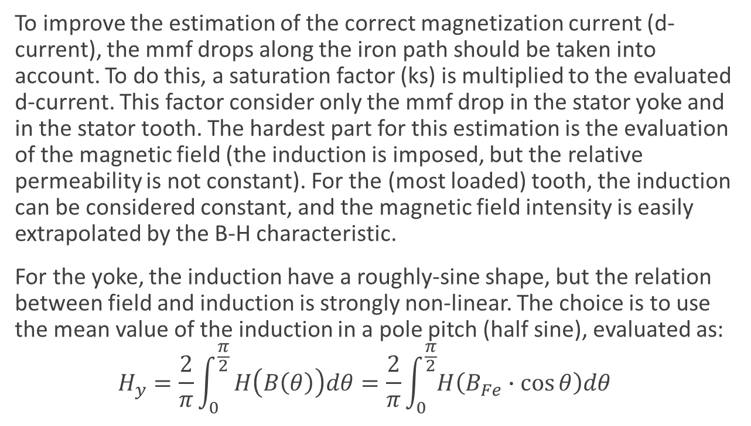
d-axis evaluation: saturation factor
To improve the estimation of the correct magnetization current (d-current), the mmf drops along the iron path should be taken into account. To do this, a saturation factor (ks) is multiplied to the evaluated d-current. This factor consider only the mmf drop in the stator yoke and in the stator tooth. The hardest part for this estimation is the evaluation of the magnetic field (the induction is imposed, but the relative permeability is not constant). For the (most loaded) tooth, the induction can be considered constant, and the magnetic field intensity is easily extrapolated by the B-H characteristic.
For the yoke, the induction have a roughly-sine shape, but the relation between field and induction is strongly non-linear. The choice is to use the mean value of the induction in a pole pitch (half sine), evaluated as:
$$H_{y}=\frac{2}{π}\int_{0}^{\frac{π}{2}}{H\left(B\left(θ\right)\right)dθ}=\frac{2}{π}\int_{0}^{\frac{π}{2}}{H\left(B_{Fe}∙\cos{θ}\right)dθ}$$

Slide 8
Minor modifications
Additional minor modification are done, as:
Correction of the Lqfpu, using the “real” geometry definition, with evaluated permeance
Use of the saturated staircase for the flux carrier design

